Slide 1
Business Pitch
Author
Institutional affiliation
Instructor
Course code
Date of submission

Slide 2
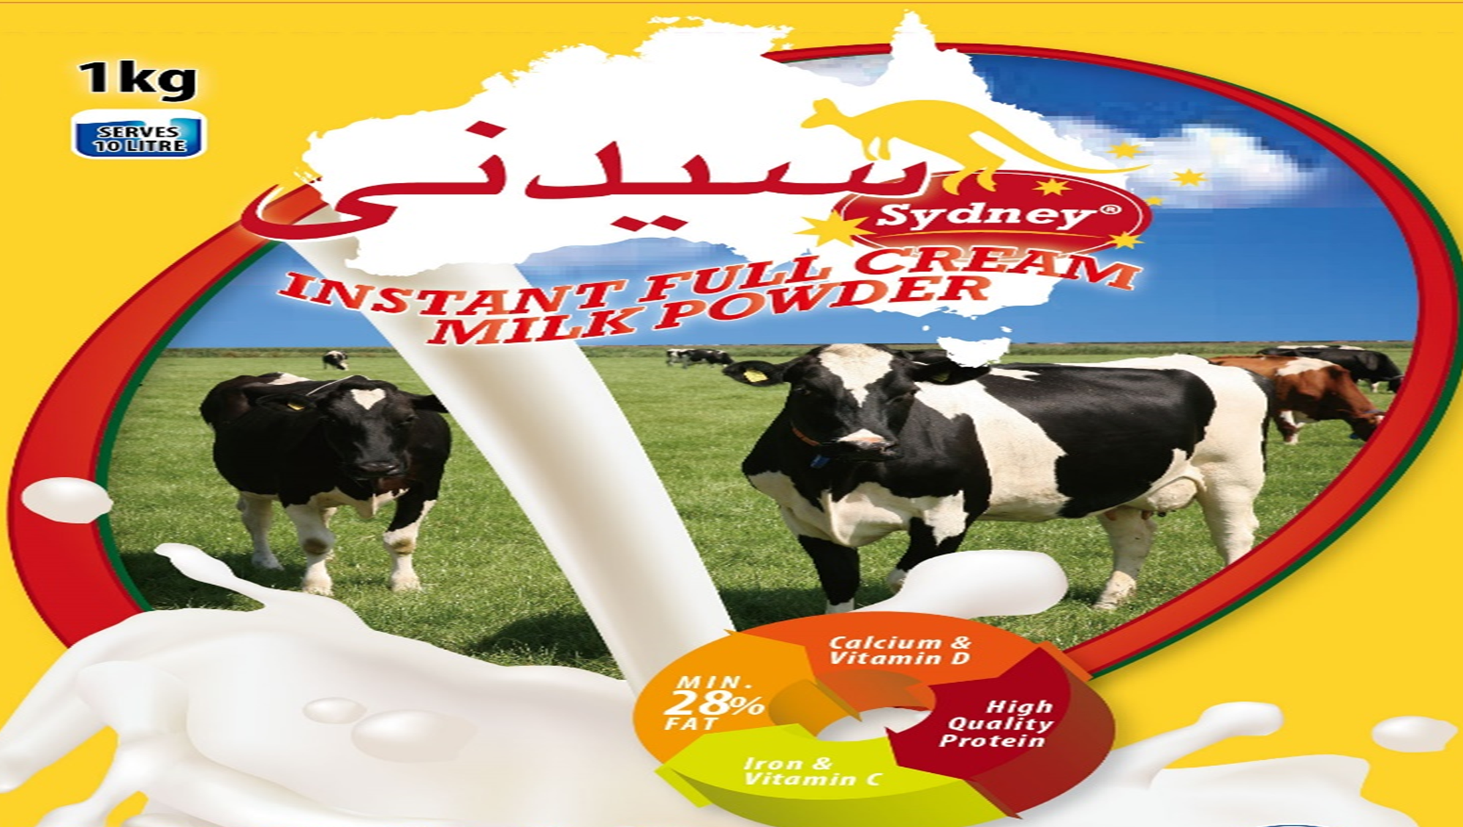

Slide 3
Mission and vision of the company
The Arabian region experiences various constraints that significantly limits the region’s ability to produce sufficient milk to meet the dietary requirements of the people in this region.
For this reason, Sydney Instant milk powder company seeks to become a leading exporter of milk powder products to the middle east to provide essential dietary elements required for the sustenance of livelihoods.
Australia produces substantial amounts of milk products which the company seeks to use to increase the regional supply in the Middle East.
Similarly, taking advantage of the situation in the Middle East, Sydney Instant milk powder has the vision to be a leading player in the milk market in the region.

Slide 4
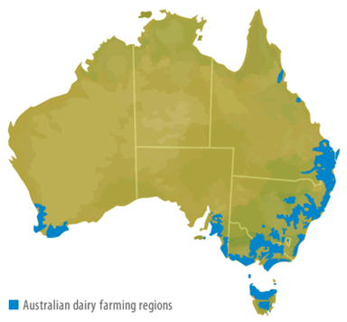
An image showing the dairy farming regions in Australia

Slide 5
The team
To ensure success in the middle east, Sydney instant milk powder would require the cooperation of the local industry leaders both in Australia and in the middle east.
Murray Goulburn and Fonterra Australia would be the company’s key partners in the development of the new product. Team formation is an essential aspect in new start-ups to particularly reduce the risks of failures and uncertainties.
For this reason, Sydney instant milk powder company understands the importance of team collaboration in ensuring that the project is a success.

Slide 6
The problem
Due to the harsh climatic conditions and the infancy of cold chain in the middle eastern region, the region has continued to experience significant shortages in milk production despite the general increase in demand of the essential commodity.
The climatic conditions in the region act as a major obstruction towards the realization of increased milk production in the middle east.
This has consequently resulted in deficiencies especially due to the increase in awareness of health-associated benefits of milk consumption.

Slide 7
The solution
To be able to meet the growing demand for milk products in the region, external supply is required.
This is arguably the only solution available considering the region’s inability to sustain sufficient internal production.
Admittedly, the local processors in the region have failed to sufficiently address the growing demand. For this reason, Sydney instant milk powder company seeks to complement the local supply of milk products in the region by bringing in powdered milk products.
Believably, this would help in relieving the pressures on the local producers who have not been able to effectively address the growing demand.

Slide 8
The market opportunity
Despite the efforts by the local producers in the region, the regional milk production of milk has remained considerably low.
Drinking of milk and use of powdered milk has indicated strong performance in other middle eastern countries such as Syria and Lebanon.
UAE is also witnessing a gradual growth in the demand for milk products especially due to an increase in awareness of health-related benefits of milk besides the increase in per-capita income.
Similarly, due to the increased focus on healthier foods as advocated by who, the region has seen a drastic increase in demand for milk products which are considered healthier and more nutritious food alternatives.

Slide 9
Cont.….
In this sense, Sydney instant milk powder company has great growth potential for growth in this region because the increasing demand for milk products in the region has observably burdened the local producers especially due to unfavorable climatic conditions.
In this view, importation of milk products is the only better way to address the increasing demand.

Slide 10
The product
Admittedly, milk, a product from the dairy animal, is considered an essential and nutritious food commodity for humans providing essential elements in the human diet.
Milk is considered is arguably the cheapest source of animal protein and vitamin d. Due to the limited production of milk in the Arabian region, Sydney instant milk powder company seeks to export this essential food commodity to the middle eastern countries.

Slide 11
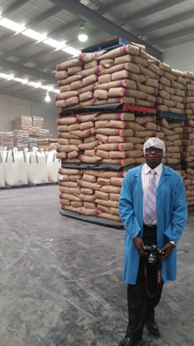
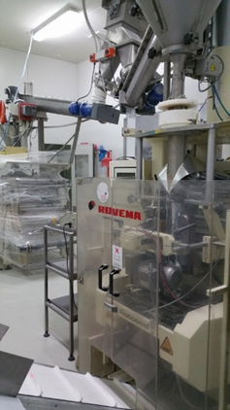
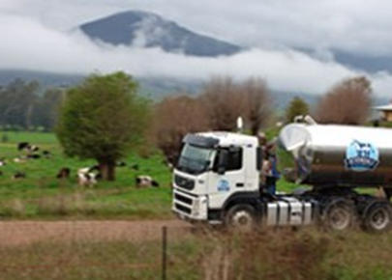

Slide 12
The customers
The company seeks to engage in a diversified market.
The sales of milk powder products in the middle east would target the general population. However, it is essential to note that the company’s initial sales would focus on the working population.
The company intends to bring milk products at the convenience of the local consumers at considerably fair and affordable prices.
It is essential to note that the powdered milk which contains the essential vitamins d and a would be available in almost all the stores countrywide for easy access by the customers.

Slide 13
The technology
Tankers transport the milk from dairy farms to the nearest milk processing plant. These are located near the farms so the milk doesn't have far to travel.
On arrival, milk from the tanker is tested again in a laboratory to ensure that it has been kept at or below 4 degrees Celsius during transport, and has been delivered within 24 hours of milking.
The tests also monitor protein levels and check for the presence of bacteria and antibiotics.
The milk is then pumped into large insulated vats at the factory ready to be turned into high-quality milk powder. Manufacturing and packing of our milk powder meet the high standards required by the dairy industry food act, export control (milk & milk products) HACCP & GMP.

Slide 14
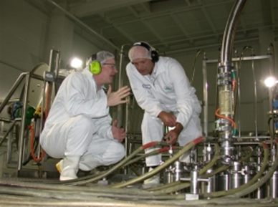
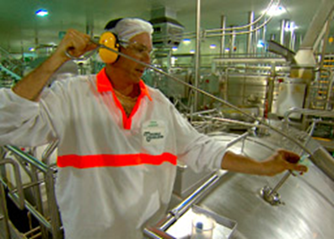
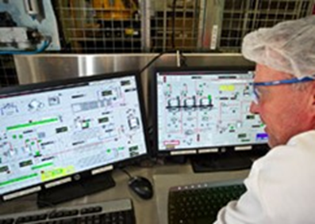
Advanced manufacturing process

Slide 15
Competition
Currently, other than the local producers, Netherlands and Belgium are the exporters of milk in the region however, the two countries have not been able to effectively address the regional milk insufficiency.
Australia, rather known as the island of production is a major agricultural producer and exporter of milk and associated milk products (Griffiths, 2010).
Due to high-quality produce and expertise, the country has earned a global reputation in the production of high-quality milk products.
Believably, this would assist in the alleviation of presumed competition in the middle market in the middle eastern countries.

Slide 16
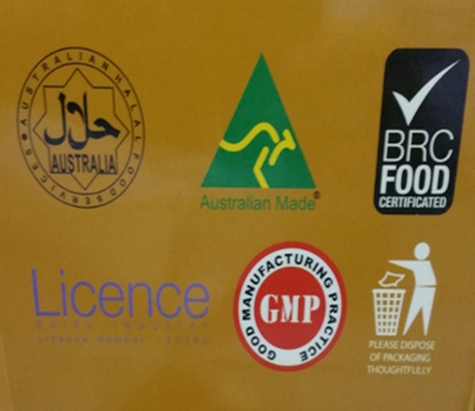

Sydney instant milk powder is certified

Slide 17
Consequently, Australia's food and agricultural products are well known for being safe, nutritious and high quality.
Australia’s dairy industry is no exception with Australian dairy products being recognized as superior and in demand all over the world.
In a sense, the company’s idea to export milk to Syria would be a better strategy as the producing country is way ahead of the other competitors in terms of quality and safety.

Slide 18

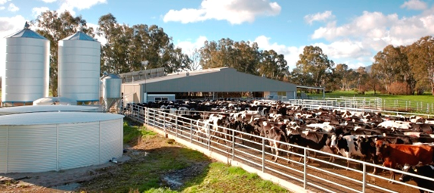
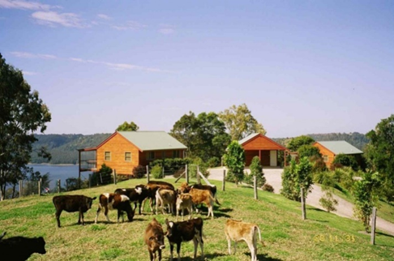
Ideal production conditions in Australia

Slide 19
Business model
After processing the fresh milk sourced from the local farmers in Australia, the skimmed milk would be transported to the middle east via sea for display in the local stores. The company seeks to earn revenue from the sale of milk powder products.

Slide 20
Marketing plans
Sydney instant milk powder intends to use T.V commercials to popularize the new product in the middle east.
In order to gain higher customer’s purchase intentions, Sydney instant milk company would apply the use of tv commercials to particularly helpful in building trust in the mind and perception of the customers.

Slide 21
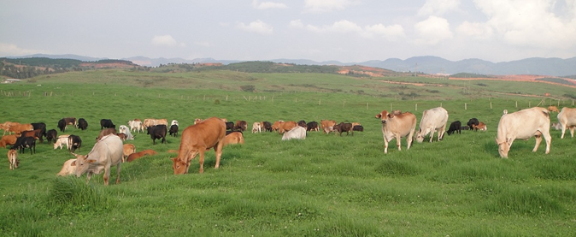
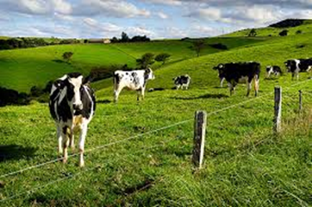
Ideal production conditions in Australia

Slide 22
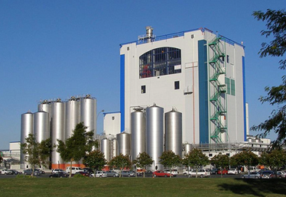
Advanced production technology

